Slide 1
CEDB1160 Project- white wine quality enhancement analysis
Samer Kareshe

Slide 2
Research Question
My approach for data analysis is focusing on enhancing the white wine quality based on the existing physicochemical testing results for the below features
Fixedacidity | volatileacidity
citricacid | residualsugar
chlorides | totalsulfurdioxide
freesulfurdioxide | Density
pH | sulphates
alcohol | quality

Slide 3
Dataset
The white wine dataset is related to vinho verde white wine samples, from the north of Portugal. The goal is to model wine quality based on physicochemical tests
https://archive.ics.uci.edu/ml/datasets/Wine+Quality

Slide 4
Implementation plan
conduct a correlation exercise and highlight the high correlated features with the quality one
apply machine learning and predicting the quality as a target by using the rest of the features then plot the distribution value for differences between real and predicted values
Populate a new feature based on the previous correlation and conduct the step 2 and finally provide insights about the results

Slide 5
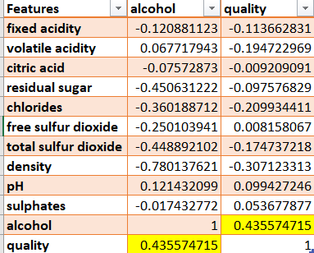
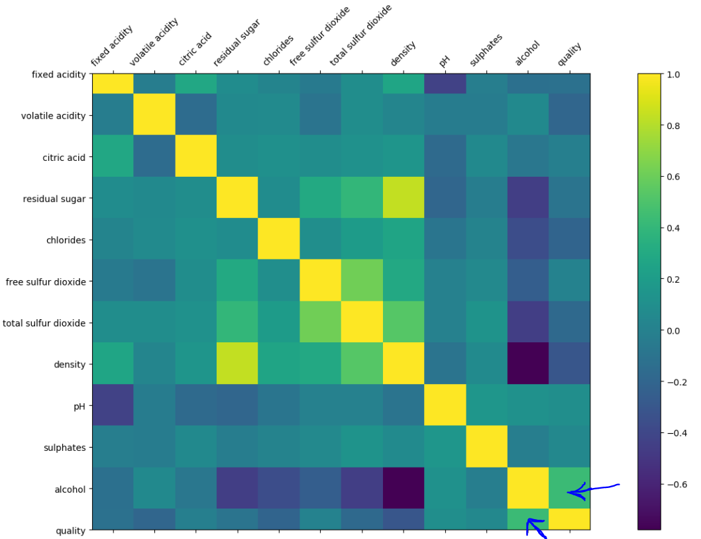
Implementation – 1: features correlation
Alcohol is highly correlated with the quality

Slide 6
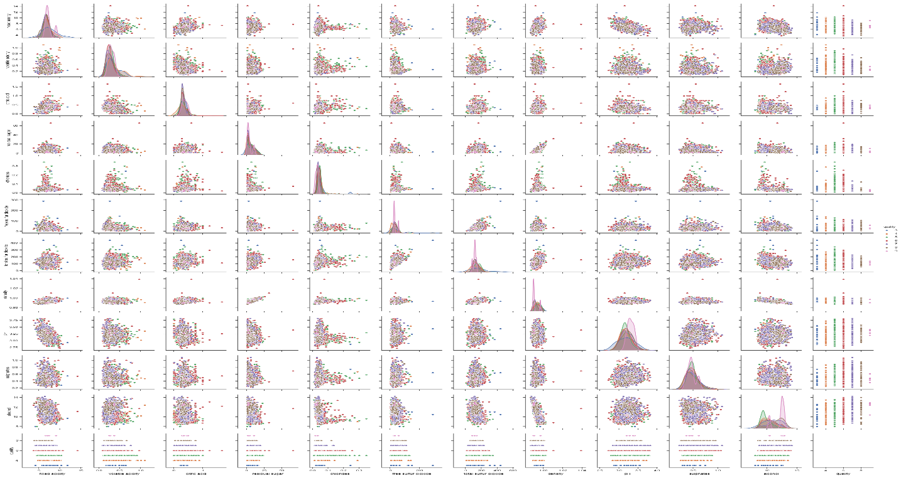

Slide 7
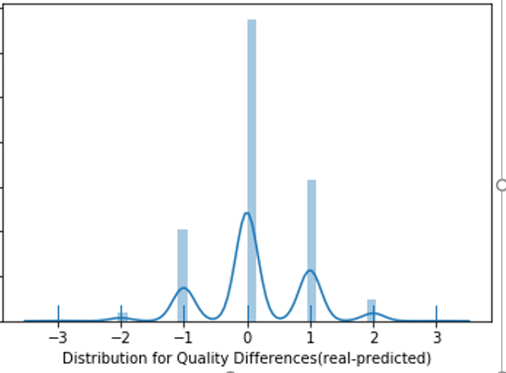
Implementation – 2: ML v1
Apply ML Model: Logistic regression on quality feature based on the rest of physical tests (features) and highlight the differences

Slide 8
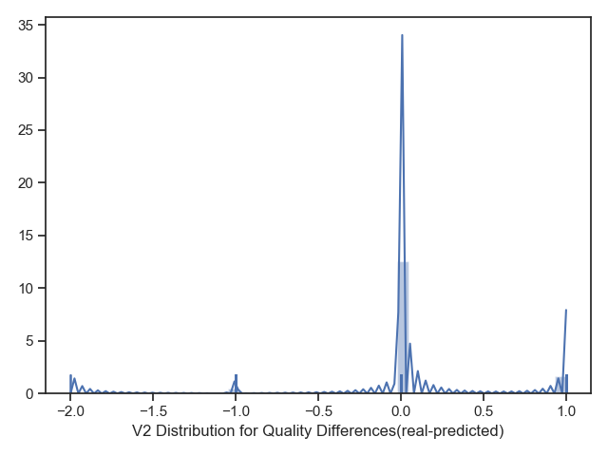
Implementation – 3: ML v2
Increase alcohol feature by 1% from its mean value and drop the old feature
Apply ML Model: Logistic regression on quality feature based on the rest of physical tests (features) and highlight the differences
as a result, the distribution plot became
more accurate and less variation

Slide 9
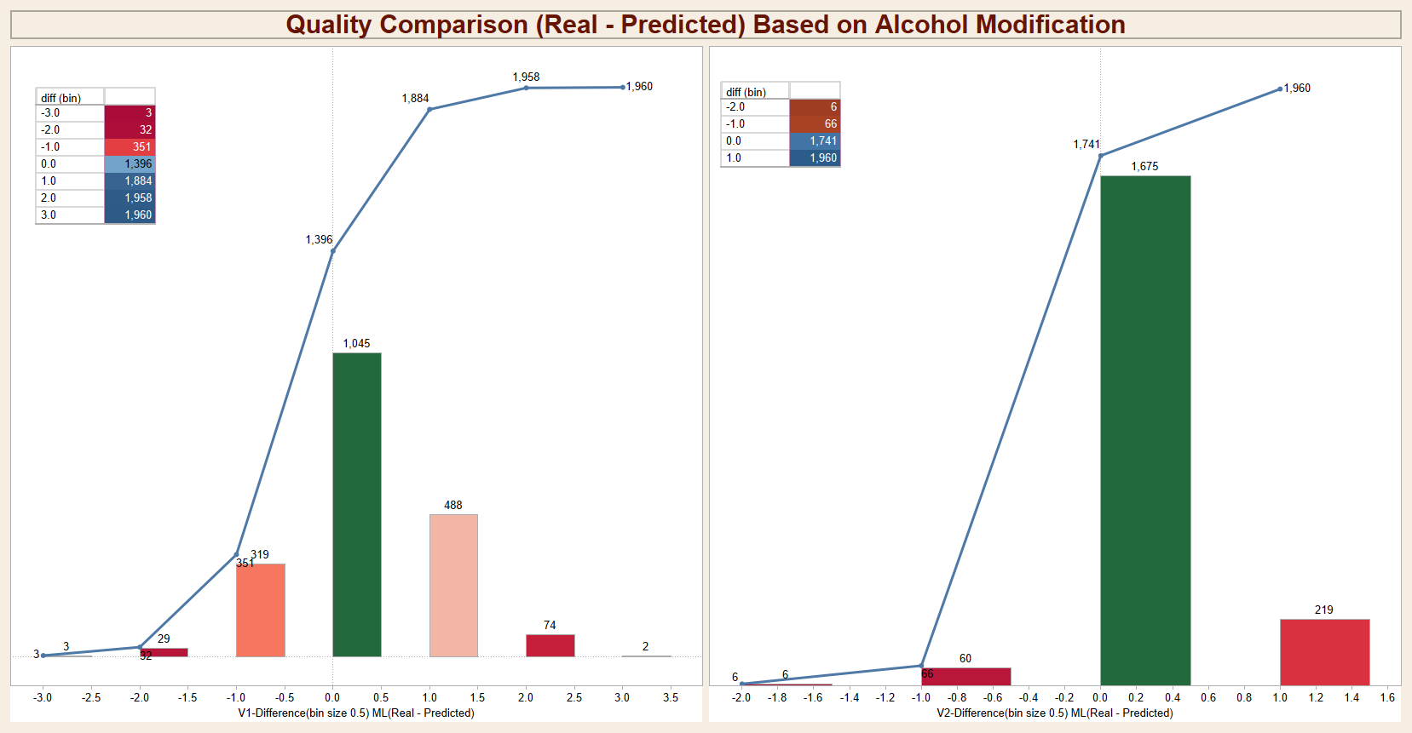
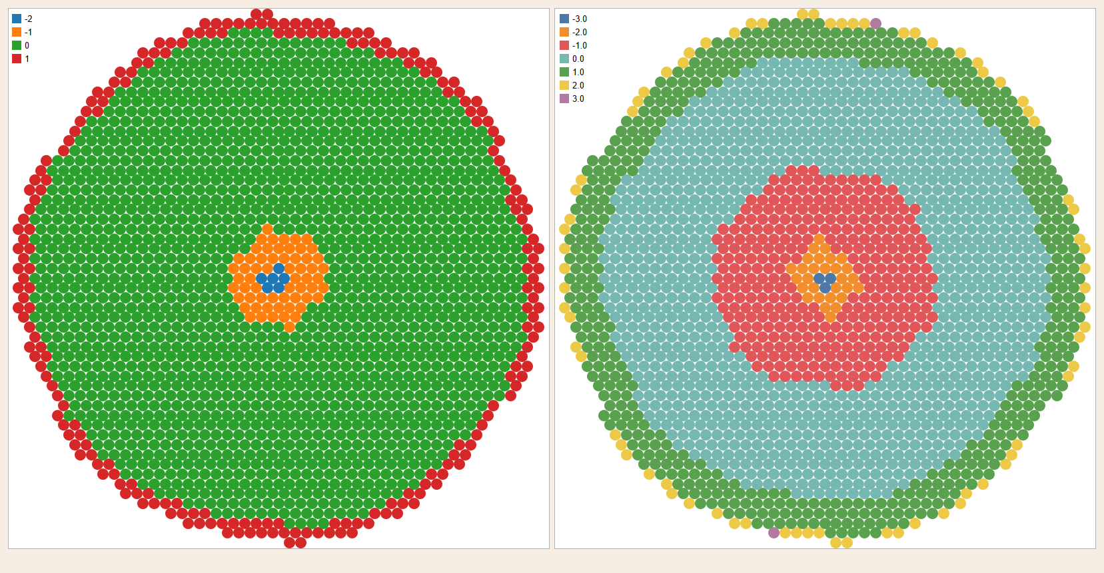

Slide 10
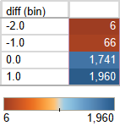
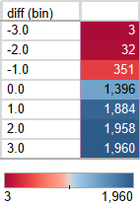
conclusion
The differences variation rate has been enhanced by the assumption of alcohol feature modification
First scheme distribution rages for differences
Second scheme distribution rages for differences
The white wine quality is highly impacted by alcohol rate.
We could have better white wine quality by increasing alcohol%

